Slide 2
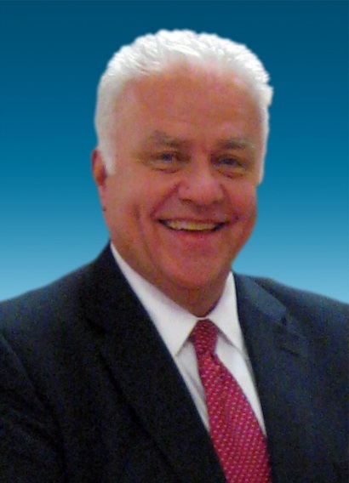
Ingredients of a Successful NMA Chapter
in Good Times and in Challenging Times
Today’s CLT Facilitator:
Steve Bailey, CM
NMA Executive Director
Dayton, OH

Slide 3
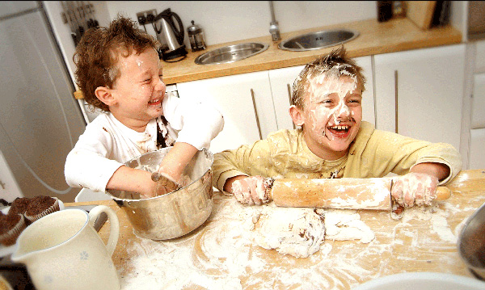
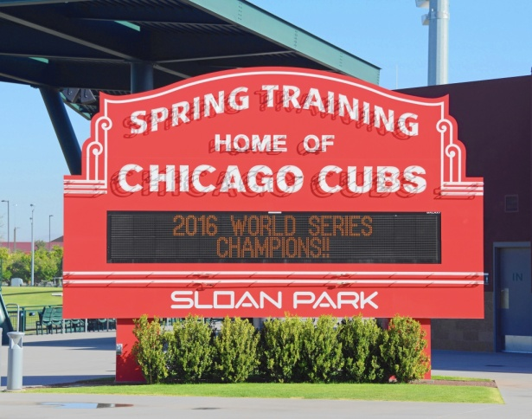
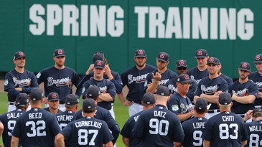
Thank YOU for serving your chapters
Notes:
Thank you and Good Morning!
As we start, we must thank YOU – for taking a position within your chapter and for giving up part of your morning to come to spring training.
Even the most successful baseball players, many earning millions of dollars a year, dedicate time and a lot of money to spring training.
Why, everyone gets rusty. Everyone needs to practice the fundamentals. Everyone needs to assess the new players and start to get to know one another so that when the season starts, they can work together as a TEAM.

Slide 4
Now, more than ever…
Chapter leaders need to LEAD … up their “game” … sharpen their skills … and fasten their seatbelts!
Notes:
We really don’t know what’s around the corner. But if we’re prepared, we’ll be ready for it.

Slide 5
Leading is a State of Being
Today’s Learning Objectives:
Being able to recognize the characteristics of a value-added NMA chapter
Being able to spot behaviors or missed opportunities that undermine success … including the “after effects” of COVID-19
Presidents, VPs, ALL officers – Being able to lead your chapter with more impact

Slide 6
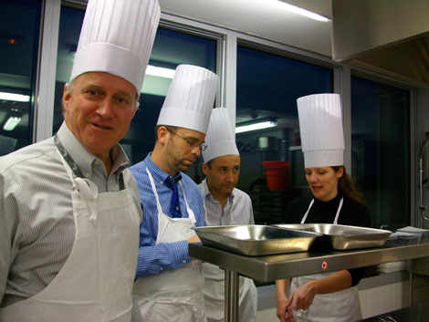
Ingredients of a Successful NMA Chapter
Notes:
Building and maintaining a successful NMA Chapter is an on-going process.
Luckily, there are no secret ingredients or hard-to-find ingredients.
First and foremost, as chapter leaders you ARE the Top Chefs and you want the freshest ideas, the most interesting choices of things to do, and a full complement of chapter programming to whet the appetites of your members.

Slide 7
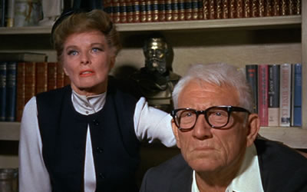
Guess Who’s Coming to Dinner?
Executive Management/Community Leaders
Human Resources/Training Staff
Existing Members
Potential Members
What do they like to eat?
What might they like to “try”?
What are they allergic to?
Notes:
Let’s take a look at just exactly who IS coming to dinner?

Slide 8
Decide What You’re Fixing!
Grab the recipe book – Start with your VISION and/or MISSION Statements
Eat healthy! Find the company goals and objectives or community needs
Use FRESH ingredients - Look for new recipes; quit fixing the same old thing!

Slide 9
Set Your Table
Take stock of the “Brand” of your chapter
Pay attention to details
Use some “stretch” fabric
Set placecards for new people, show them to their seats
Anticipate the unexpected
Never forget you’re the HOST
Notes:
Brand your chapter – why? Because people eat with their eyes first. How do people “See” your chapter?
Details – because the little things matter
Stretch fabric – stretch the limits a bit, do something different
Placecards – get new members engaged early
The unexpected – always have a back up plan and a back up TEAM
A host makes it all seem natural and positive and upbeat.
Look out for peoples’ needs

Slide 10
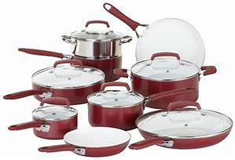
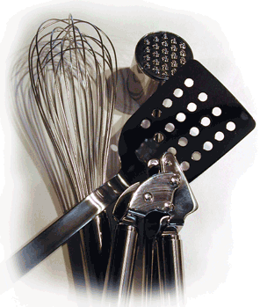
Assess Your Cooking Tools
Executive Management Support
Officer Transition Plan
Chapter Meeting Yearly Plan
Professional Development Program Plan
Community Service Activity Plan
Budget Allocations
Membership Growth Plan
Notes:
What condition are they in?

Slide 11
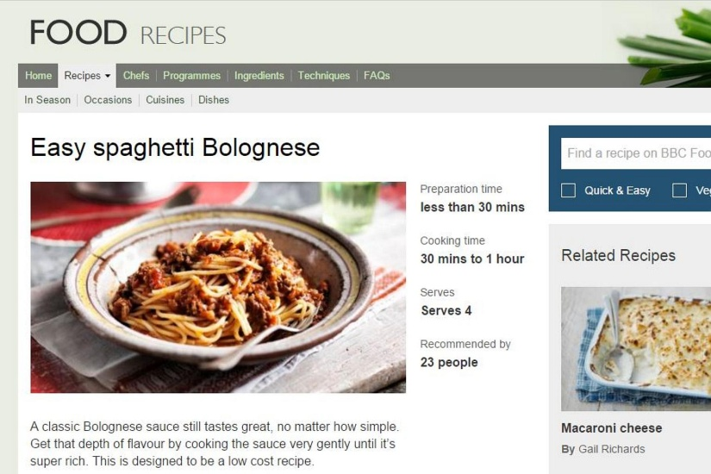
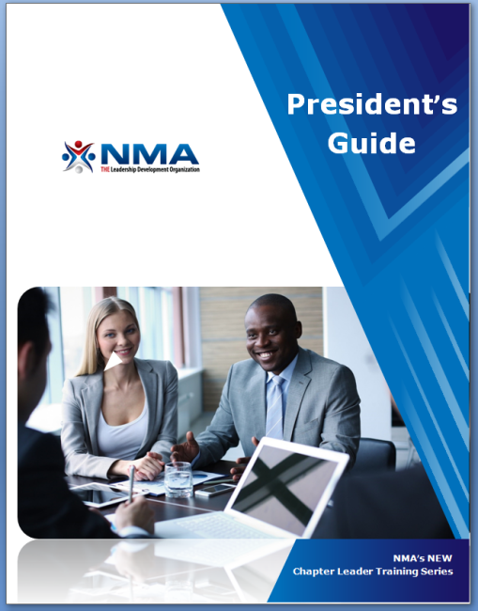
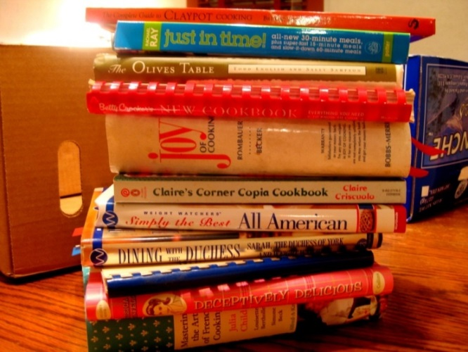
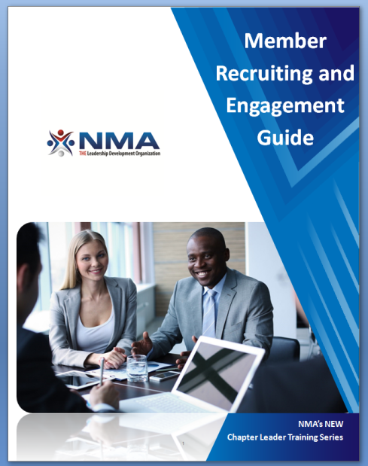
What Cookbook Do I Use?
All at nma1.org
Notes:
It’s ok to “cook from scratch” … but only if you’ve had lots of practice and years of experience.
If you’re fairly new to leading the chapter, it’s best to find some tried & true … and tested … recipes.
The guidebooks will help

Slide 12
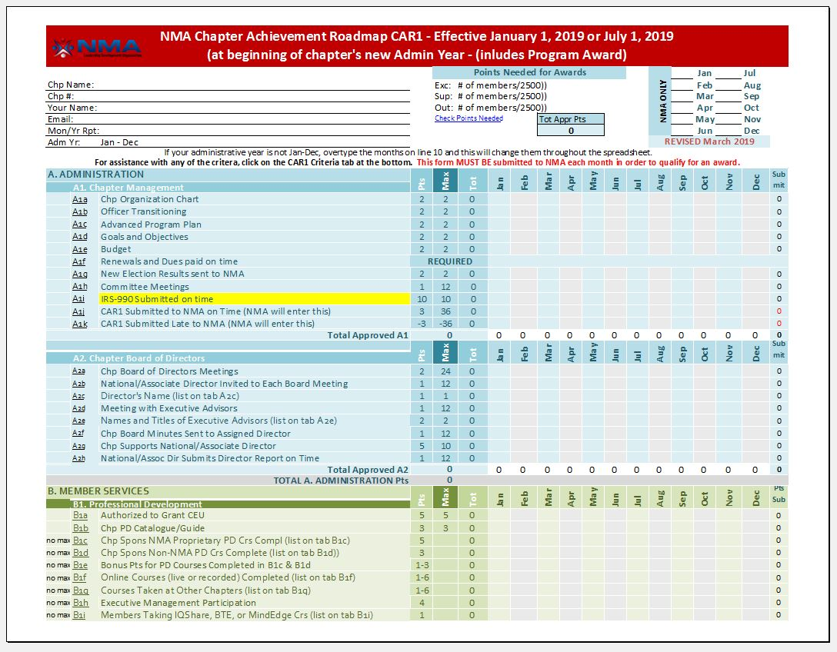
The NMA CAR1 Cookbook!!!
Notes:
Often called a roadmap, for today’s purposes I’ll call it Step by Step Instructions for the Novice Cook
Get your hands on it before you start to put your meals together.

Slide 13
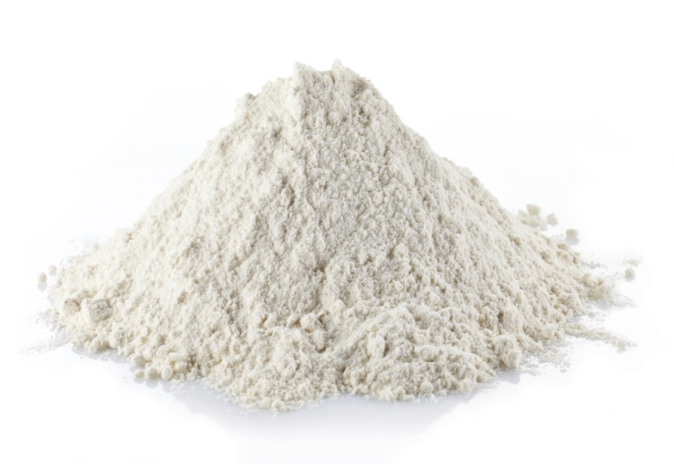
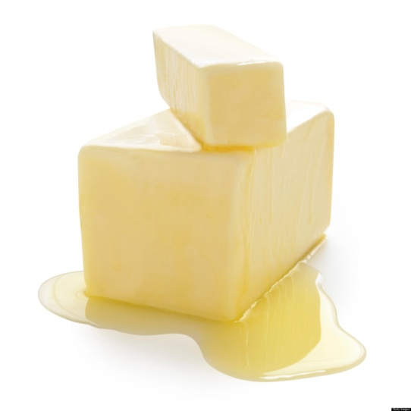
Recipe Ingredients
First, line your pan with:
1 cup All Purpose Executive Management Input, mixed with melted WIIFM and…
Notes:
Without executive management input and support, your cake isn’t going to rise!
Here this – self rising flour isn’t going to work. The best chapters reach for the cake flour – they make sure to seek out executive management engagement and keep a supply on the shelf. They don’t let it get old and they keep it replenished by keeping in contact with senior leaders.
Even execs have a WIIFM – what’s in for THEM to support you. Do they know?

Slide 14
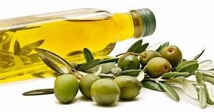
Recipe Ingredients
3 Tbsp. Human Resources and Training Department Essential Oils
Notes:
They are in charge of performance management, training, and organizational development and culture.
YOUR job is to support them and partner with them.

Slide 15
From: Chapter Management Pantry
1 completed chapter org chart
1 cup chapter officer training & mentoring
1 set of published goals & objectives
1 published budget (adjust seasoning as necessary)
12 mo. NMA Membership Renewal Forms
1 pkg. Election Results sent to NMA

Slide 16
From: Professional Development Shelf
1 B-3 form (Request to Grant CEU)
1 large PD Plan of Action
1 cup varied PD offerings
1 T Executive Management Participation
2 tsp CM (Certified Manager) Activities
3 pkgs new FaciliSkills courses
1 envelope of Building Virtual Teams
2 cups company HR linkages
Notes:
Webinars, seminars, TED talks,
2 cups company HR linkages = those essential oils I mentioned a moment ago!

Slide 17
From: Communications Cupboard
Chapter Newsletters to taste
4 tsp regular PD activity reminders
1 can of chapter website updates
¼ tsp published links to nma1.org
2 T articles submitted for NMA Breaktime
2 T postings on your own or NMA’s Facebook page, blog, or Twitter(@nmaleaders)
Notes:
Keep your website updated!
Don’t substitute personal outreach with electronic messaging!
Don’t just announce your programs – MARKET THEM

Slide 18
From: Association Development Cooler
1 large Membership Growth Plan
1 pint of leverage via our 2020 Membership Campaign
2 liters Chapter Marketing Materials
3 cups “qualified” lead referrals to NMA
4 cups – Participation in Chapter Growth Incentive Plan - $25 for each new member of each new chapter!

Slide 19
From: Association Image Drawer
1 cup local chapter press coverage
1 Silver Knight or Leadership Award ceremony
1 cup Chapter Member of the Year Award plus ½ cup submission for national MOY
3 cups Executive of the Year & Hall of Fame nominations sent to NMA – by June 15
1 large serving Top Management Night programs

Slide 20
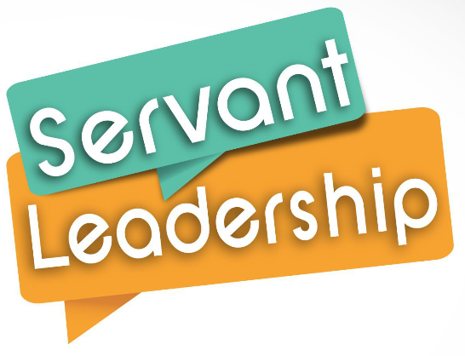
From: Community Services Cabinet
1 Speech Contest plan
2 cups youth programs
3 cups organized community events
4 cups Ingenuity
3 T support/organization for company or community events
3 tsp Management/Leadership Week in America programming
Notes:
Ingenuity - do NEW things. Ask for peoples’ hot buttons in terms of community service. THAT is how you get people engaged!!!!

Slide 21
Mix all ingredients together & add:
1-16oz. can New Member Orientation
2 scoops of communicating with your assigned National Director and/or Associate Director
3 scoops of membership roster updates to NMA
1 yearly consideration of supporting a
National Director or Associate Director from your chapter
1 cup of purely social gatherings

Slide 22
Before baking, sprinkle with:
Membership surveys and feedback
Regular meetings with your advisors
Familiarity with NMA’s website
Ongoing recognition for your colleagues
“The strength of the team is each individual member. The strength of each member is the team”
Keith Ferrazzi

Slide 23
What’s going on here???
Notes:
These people are obviously having fun. They are getting to know one another after a hard day’s work. Employee engagement begins with getting to know one another on a social level. It is a HUGE component to a successful chapter.

Slide 24
Before putting it in the oven …
Ask yourselves, “Is NMA THE PLACE to be around here?”
Notes:
With everything you now know, is your chapter fun, is it cool, does it “look” like The Place to be … and lastly, IS IT The Place to be?
If you are surrounded by ERG’s (other Employee Resource Groups), set yourselves apart. As for this particular picture, I’d like to thing of it as you folks listening today, leaving our virtual CLT and having fun, yourselves, as you put all the ingredients together for a great year.

Slide 25
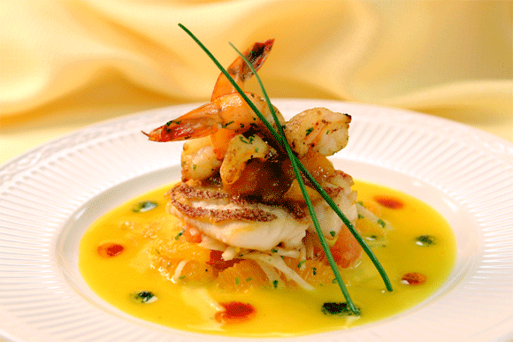
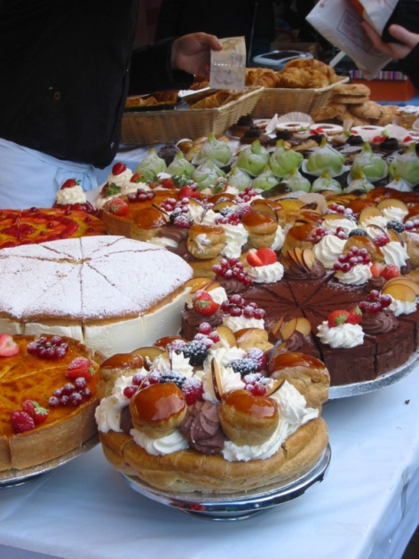
Then…
Cook according to directions … and
await your masterpiece.
Notes:
Nurturing a successful chapter is an ongoing process.
Every year our chapters change officers and every year we are faced with new challenges and opportunities.
You and I have two main tasks in front of us: to prepare all our officers to do their jobs well, and to create a chapter atmosphere that brings favor and distinction to all we are trying to do.

Slide 26
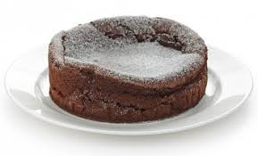
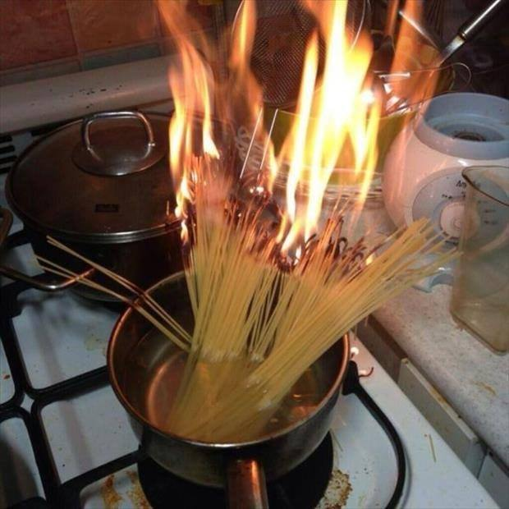
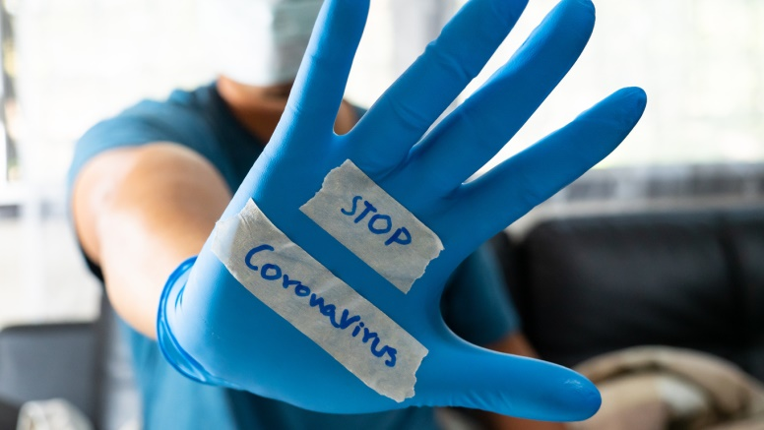
Ingredients of a Successful NMA Chapter
But what happens when things go awry?

Slide 27
How to Lead a Chapter in Challenging Times
A leader with high emotional intelligence, forethought, and experience is essential. He or she will GROW in the face of difficulties.
You know your chapter
You know your members
You are in touch with senior leadership
You adopt a “No guts, no glory” mindset
You make working from home WORK for you!

Slide 28
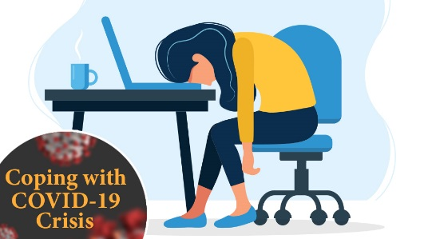
How to Lead a Chapter in Challenging Times
Everyone has approached current realities differently and everyone is affected by it differently.

Slide 29
4 Tips for Working from Home
#1. Create “work” triggers for your brain
Notes:
When you work in an office, the daily routine of getting ready and commuting helps your brain get ready for the day. When you’re working remotely, you can create “start the day” triggers that get your head ready for work in a similar way, like exercising, reading the news, or making coffee.
A workspace may also be key. If you can sit down and be productive anywhere, that’s great. If you need more structure, establishing a designated workspace — whether it’s a separate room, a fully stocked desk, or just a clean part of your kitchen table — can help tell your brain you’re in the place where you do work productively and without distraction.
About distractions: They’re one of the biggest challenges of working remotely. To keep your brain in the right mode, avoid doing nonwork tasks during your work time. For example, schedule a separate time to do laundry instead of tackling it while you’re finishing a work presentation.

Slide 30
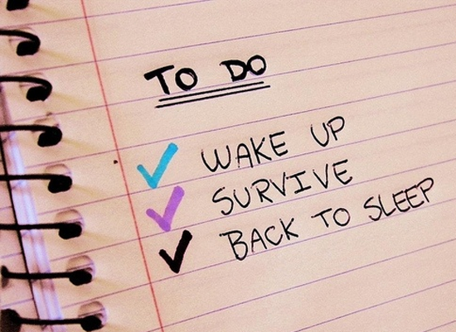
4 Tips for Working from Home
#2. Stay motivated with a list
Don’t make these 7 mistakes:
Thinking there’s only one “right” system
Putting too many things on your list
Not prioritizing your tasks
Listing projects instead of tasks
Being productive instead of effective
Making only one To Do List
Not making your list beforehand
Notes:
A simple to-do list can do wonders for keeping you both organized, motivated, and productive as you work from home. As you create your list, think about big, long-term goals, like finishing a project, as well as small goals, like completing tasks that lead to that big goal.
Checking off those smaller goals lets you know you’re making progress, which gives you positive reinforcement throughout your day. And work feels much more doable when it’s not all one giant task.
Write or type out your list instead of just having it in your head. You won’t have to devote headspace to constantly remembering what you have to do, and the pleasure of crossing tasks off your list can help you stay motivated.

Slide 31
4 Tips for Working from Home
#3. Make a schedule for everything
Notes:
Remote work requires a schedule much like a typical office job, except you’re the only one holding yourself accountable. That doesn’t mean your entire day has to be work only (it’s actually important to take regular breaks to refresh yourself mentally, physically, and emotionally), just that any nonwork activities also need to be scheduled.
When creating your schedule, take into account the other commitments in your life and find a routine that lets you take care of those as well
Once you’ve set your schedule, make it visible to your coworkers with a shared calendar. This way, they’ll know when you’re free to meet and when you’ve blocked out work and personal times. It’s also a good idea to make sure friends and family understand your schedule and respect it. Set boundaries and expectations by letting them know that working remotely doesn’t mean you’re free all the time.

Slide 32
4 Tips for Working from Home
#4. Create a process for collaboration
Notes:
Working from home might seem like a solo experience, but it usually still involves interacting with others, whether it’s meeting with your team, getting assignments, making decisions, or giving and receiving feedback. So it’s important to set up methods for collaboration while you work remotely, such as videoconferencing.
While email can be effective for making an official decision or passing on information, people’s inboxes can get clogged up quickly. If you need to ask a quick question or send a fast update to your team, chat apps like Google Hangouts or Slack are a good alternative to email.
Brainstorming or detailed discussions usually require an official meeting. Talking face to face can often help collaboration, so you might consider videoconferencing for these moments. Videoconferencing is also a great way of having regular check-ins with your team. This can help you stay abreast of what others are doing, and also help everyone keep up a rapport that might otherwise go neglected from not sharing a workplace.

Slide 33
5 Tips for Becoming an
Effective Chapter Leader in Difficult Times
#1. Master Your Own Fear
“Leadership is the ability to hide your panic from others.”
- Lao Tuz
Notes:
A good leader cannot be expected to be completely fearless in the recesses of his or her mind. If you have something at stake, you will have fear and doubt.
Keeping things in perspective is one of the best ways to manage your own fear so that you can continue inspiring others. Every chapter in the country is going thru the same thing. How do you get things going again? How do you rev up a membership drive? Believe that you and your team will get thru it all. It's a learning experience.
Regardless of your situation, you need to manage your own fears and doubts so they don't become contagious. Make the best decisions you can with the information you have. Remain transparent in your decision-making process and get everyone engaged when you can.

Slide 34
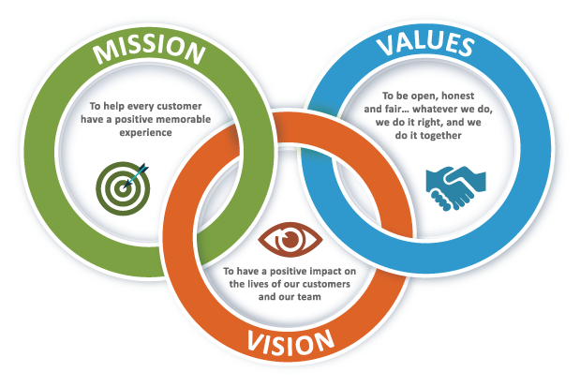
5 Tips for Becoming an
Effective Chapter Leader in Difficult Times
#2. Love & Respect Your Mission
“The courage of leadership is giving others the chance to succeed, even though you bear the responsibility for getting things done.”
- Simon Sinek
Notes:
In almost any situation, it's common to come across the dilemma of doing what's best for the person or organization you love … or doing what you want personally. You'll face this as an association leader as well.
Every association has a mission and the chapter’s mission comes first over individual objectives. This can be difficult. You take pride in their work as the leader of that mission. Yet in difficult times, sometimes you must look beyond yourself and ask if your actions and decisions are best for the mission (and the chapter) , or best for you. Is this a feather in your cap or the future of your association? A great association leader will strive to see the difference.
The board and the members have entrusted you with the chapter's care and longevity. This is a humbling role. Do your best to keep your personal interests out of the decision-making capacity.

Slide 35
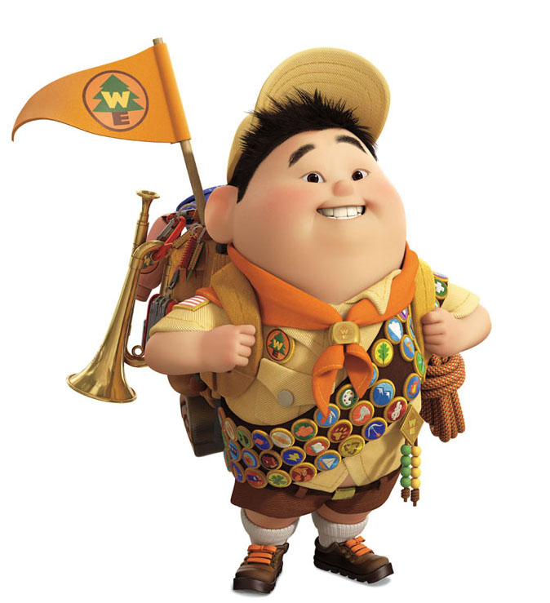
5 Tips for Becoming an
Effective Chapter Leader in Difficult Times
#3. Be Prepared
“No matter how many times you save the world; it always manages to get back in jeopardy again. .”
- Mr. Incredible
Notes:
(Robert “Bob” Par, the protagonist of Disney-Pixar’s 2004 animated film, the Incredibles and the 2018 sequel.)
A good leader reacts quickly with the best information they have. An exceptional leader surveys the horizon and prepares for possibilities so that when difficult times approach they're ready. For today's leader that involves identifying NOW what challenges you are going to face when everyone gets back. You and your leadership team should be talking and communicating and Zooming this coming week if you haven’t been doing so already.
You don't know if your next challenge will be internal or external but having a contingency plan for what-ifs and worst case scenarios will improve your ability to handle the situation.
When people are engaged in activities that they enjoy and can see they are important to the company’s success, that's what brings out the best of their talents. This passion needs to be modeled by leaders. Even in the darkest of times, winning leaders have “attitude.”

Slide 36
5 Tips for Becoming an
Effective Chapter Leader in Difficult Times
#4. Keep Learning
“Courage is what it takes to stand up and speak; courage is also what it takes to sit down and listen.”
- Winston Churchill
Notes:
Children frequently lament that they can't wait to be done with school. They want to be adults because there isn't any homework. While there might not be exact pages assigned to you every night, as a chapter leader you need to be listening and learning every day from your members, peers, and industry experts.
Each of us needs to consider what we have learned these past few weeks. How has it changed you? What will you be doing differently when you return to work – both short term and long term. Think of that in terms of your chapter and its activities. What may very well change?
A good leader keeps an open mind and learns from examples of what has and hasn't worked both historically and today. There is no better way to improve your chapter and its operations.

Slide 37
5 Tips for Becoming an
Effective Chapter Leader in Difficult Times
#5. Get Some Attitude
“I’m in control
My worries are few
‘Cause I’ve got love
Like I never knew
Ooh Ooh Ooh Ooh Ooh
I’ve got a New Attitude”
Notes:
Good leadership is also about what’s going on in leaders’ hearts. People are very good at sensing this. It’s about passion for our company, the customer value we’re creating—and gratitude for the people who are doing it.
It’s also about the relationships that the chapter creates and fosters—both inside and outside the company. When people are engaged in activities that they enjoy and can see they are important to the company’s success, that's what brings out the best of their talents.
This passion needs to be modeled by leaders. Even in the darkest of times, winning leaders have “attitude.”

Slide 38
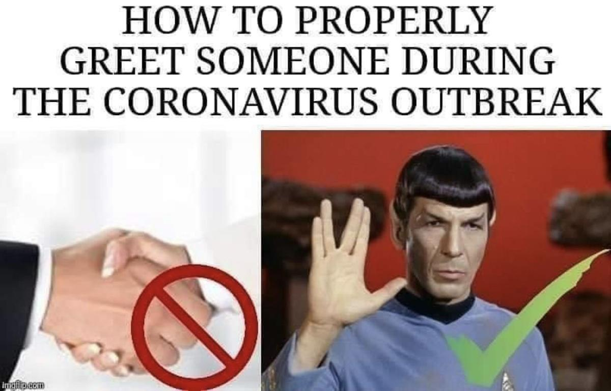
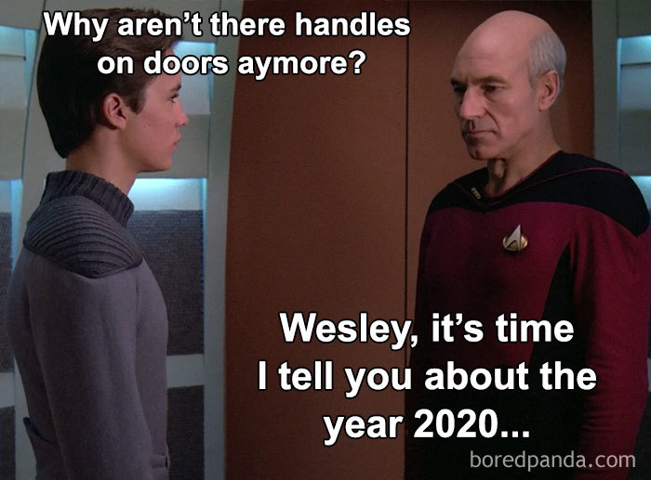
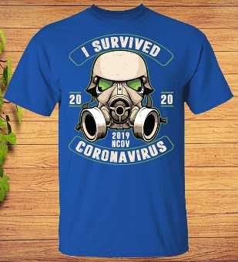
One More Tip for Becoming an
Effective Chapter Leader in Difficult Times
Keep perspective and your sense of humor

Slide 39
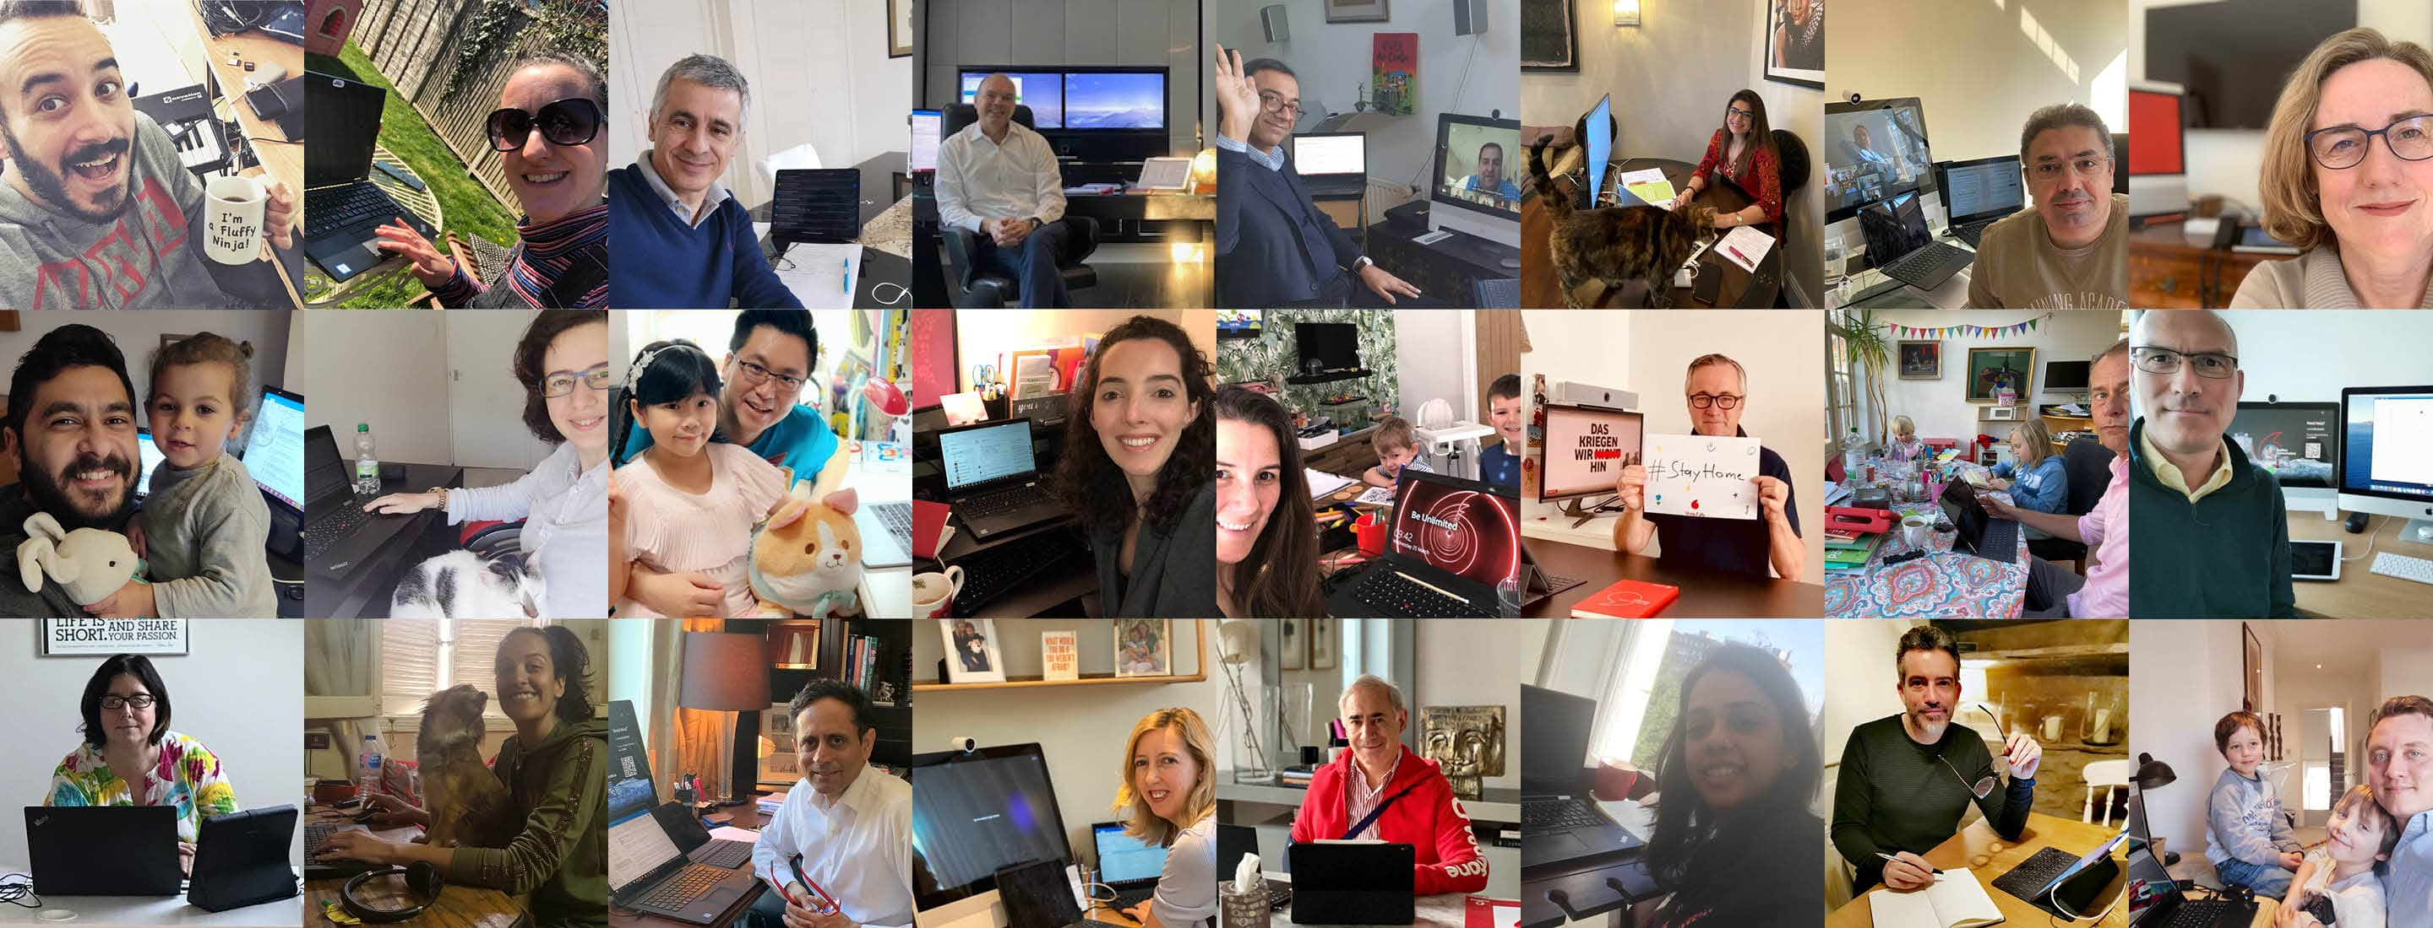
What Are Some Effective Chapter Leaders Currently Doing?
Let’s Take a Look …

Slide 40
What Our Chapter Leaders are DOING…
We have a bi-weekly meeting rhythm for our Exec Committee to maintain focus
Held a “Virtual Offsite” 4/10. Attendees included executive sponsors, Board Chair, and Exec Comm to review our strategic plan and make adjustments
Are virtually reviewing applications for scholarships from high school students
In PD, we will hold our second Mentoring Round Table, Speed Networking (Part 1) and the Leadership Laboratory virtually
Thinking ahead, brainstorming ideas to offer PMP and CM certifications online
Organizing a food drive for the local Foodbank, collecting items virtually via online store orders
Looking for ways to bolster our Linked In and WhatsApp presence in order to stay closer to our members.
Jay Patel, President, LMLA – Marietta, GA

Slide 41
What Our Chapter Leaders are DOING…
Spirits are high; people seem to be choosing to enjoy working from home
We sent links to 2 NMA Live Online Webinar recordings to our members – “Managing Relationships & Change” and “The Secrets to Working Virtually”.
I plan to send a leadership article/link to all NMA members at least once a month, or sooner if I find something that I feel would be of great benefit
Our Board has been communicating via email, Instant Messaging, and the occasional phone call
Next will be a WebEx style meeting for all of our Board members
Many of us will be participating in NMA’s free Virtual CLT, April 24th and 25th
Brian Meier, President
Boeing Fort Walton Beach Leadership Assoc.

Slide 42
What Our Chapter Leaders are DOING…
Holding 1 hr. Leadership Team meetings via WebEx
Scheduling GMM “prep meetings” 2-3 days prior to GMM, including any speakers
GMMs (General Management Meetings) now held virtually; 90 minutes; Open Video for the NLA President and speakers; optional video for members
Sending GMM invite reminders via email and Yammer (Nokia social platform)
Inviting 10-15 non-NLA Nokia employees to the monthly GMM; “Boosters” trying to get them to join.
Keeping the NMA LiveOnline Webinar promos in front of chapter members continued…

Slide 43
What Our Chapter Leaders are DOING…
Holding virtual classes from Udacity (a for-profit educational org.) education platform using Nokia WebEx or Microsoft Team to access Udacity
NLA Book Club holding monthly 90-minute Virtual WebEx meetings
Keeping track of members, keeping dues payments to NMA current, following up with all payroll deduction changes
Across the board, we are using email, Jabber (IP Phone) and virtual Nokia platforms (Jabber, WebEx, and Microsoft Teams
Marcelo da Silva Laranjeira
Nokia Leadership Association, Richardson, TX

Slide 44
What Our Chapter Leaders are DOING…
Sent an email to all members suggest activities to do while working from home. The email said, in part, “We hope to provide at least some novel resources and/or ideas to help you both in your personal development as well as leadership development”.
Topics were grouped into
Skill building
Exercise
Meditation/Self-Care
Miscellaneous
The chapter also set up a forum on SharePoint so members could share ideas for personal and leadership development while people are experiencing the shelter-in-place order.
from Leah Perreault, Lockheed Martin Space/Denver Chapter
Notes:
Thanks to Elizabeth Thomas at LMLA in Cape Canaveral for sharing

Slide 45
What Our Chapter Leaders are DOING…
We are managing as best we can and using virtual tools to communicate and collaborate.
We are partnering with the company to do our collective best when it comes to mitigating and trying to stop cross-spreading of this virus.
Personally, I have been using Google Hangouts and Instant Messaging to work with our chapter leaders.
Finding the glass to be “half full”, I’ll admit that working from home a few days a week has allowed me to catch up on some older chapter actions that need to be addressed.
Shelby Armstrong, President
Collins Leadership Association
Melbourne, Florida

Slide 46
Ingredients of a Successful NMA Chapter
in Good Times and in Challenging Times
Thanks for joining us this morning!

Slide 47
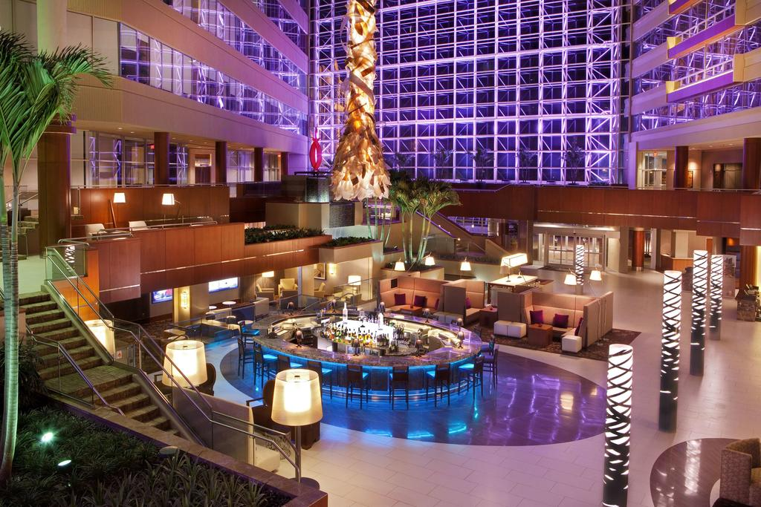
See You in Greenville, SC - October 15-18
NMA Annual Conference

