Slide 1


Slide 2
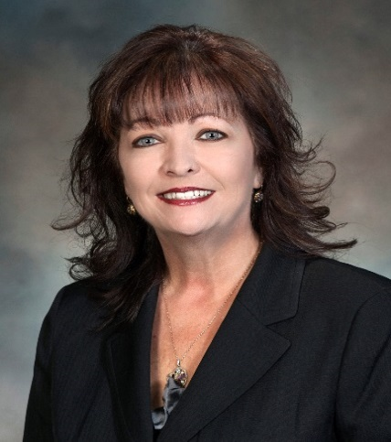
Programs and Meetings
Today’s CLT Facilitator:
Shelly Menke
2019 NMA Chairman of the Board
Notes:
Someone will introduce Shelly – probably Steve Bailey.

Slide 3

Programs and Meetings
The Programs Challenge
To take “yet another” dull, boring meeting that members feel compelled to attend, and turn it into an exciting, thrilling experience they can’t wait to get to, and don’t want to leave!!!
Notes:
Read the slide
Note; This is an introductory slide to help set the stage for the ensuing discussion.
If teaching the training live, you may Ask why people came to your Workshop and what they hope to get out of it. (You might want to take a couple of notes)
Move this along, though, so you don’t lose a whole bunch of time. Maybe ask everyone, in 5 words or less, to share one thing they hope to take home. That should do it!

Slide 4
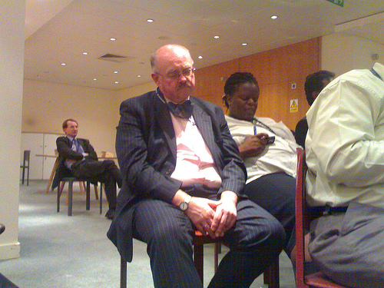
Programs and Meetings
What’s the first thing to do?
Try NOT to call it “JUST” a meeting!
Leave that term for business meetings
If you’re having a “program”…then get creative…people go to “meetings” all day long!
Notes:
Read the Slide
Note; If teaching the training live you may ask; “How can you get around that one…any ideas?”

Slide 5
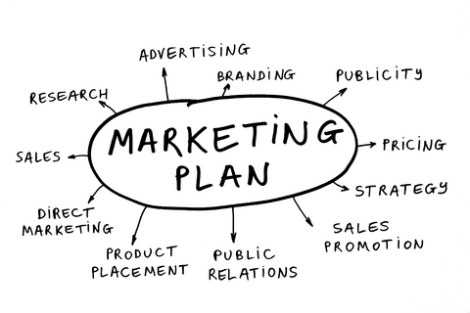

Programs and Meetings
Spice it up!!
Call it a special program or “event” if you can.
Market the daylights out of it…DON’T just announce it…MARKET it. You’re selling a product – you have to GENERATE interest!
Notes:
Read the Slide
Note; If teaching the training live;
ASK – “Do you simply announce upcoming events or do you really MARKET them?”
ASK – “How do they get the word out?”
(ex; email, flyers, communication boards)
ASK – “How do you use new technology to make people more aware?
(ex; Tweet, Facebook, Website)

Slide 6
Programs and Meetings
Let’s talk!
Think about the “best” meeting your chapter has had in recent months…
    WHY did you remember it?
    WHAT made it SPECIAL?
Notes:
READ the Slide
2) Read - At our Chapter we have held;
Hoe Down at a ranch with pumpkin carving
Oktoberfest
Mascarade ball
Murder Mystery Dinner
Casino night
Luau
911 survivor (blind speaker with seeing eye dog)
Note; IF teaching the training live, ask the attendees to Please use our chat room to answer these questions. And then we will share the answers with everyone.

Slide 7
Programs and Meetings
Competition
People working long hours
Long commutes
Childcare/“sandwich generation” issues
Other scheduled evening activities
Embroiled in work and unable to break free for lunchtime meetings
What else can negatively impact your meeting??
Notes:
Read - People are busy so we need to make it worth their while to break free and come to the NMA event.
Note; if teaching training live, ask - “How have some of you made it “easier” to talk people into coming?”

Slide 8

Programs and Meetings
Beating the competition!
Put pizazz in your program and its promotion
Highlight the topic or the presenter; relevancy
Convenient time and place
  WHEN are you holding most of your chapter programs? (Before, during, or after work?)
Appeal to peoples’ hot buttons
Make it FUN
Guarantee easy “in & out”
Notes:
1) Read the slide
2) Read - You don’t HAVE to do the same boring things, time after time!
3) Read - One of the things we did at our chapter was called “If you snooze you loose”. We would start the drawing at $50.00 & at the end of the event we would draw a members name, if they were present they would win the money. If not, we would increase the fund for the next event and continue until the pot reached $300. We would advertise in our newsletter or E-blast the names that were drawn ( lost or the name of the attendee that won. This made our members would go back and talk up our event in the work place.

Slide 9

Programs and Meetings
3 Steps to Effective Programs
Planning Ahead
Setting the Content
Staging the Meeting
Notes:
1) READ - The components of effective meetings may be broken down in a number of different ways. Here, we have determined three simple steps to follow to ensure an effective meeting.
2) READ the Slide
3) READ - Let’s take a look at them…

Slide 10

Programs and Meetings
Planning
Organize Program Committee
    Determine Functions
    Select Committee Leaders
Choose Theme or Objective
Plan Program
    Advance Planning
    Determine Budget
Notes:
READ – Here are four things to look at in terms of planning.
READ the slide
3) READ - Advance program planning is critical to success.
Don’t do this alone…have a team, a committee, or whatever it takes. The organization of your team plays a key role in the planning process.
We’ll talk about the importance of themes and objectives for a meeting.
One must allow enough time to organize and secure facilities, speakers, etc..
However, you must know how much of a budget you have before you can adequately plan.

Slide 11
Programs and Meetings
Planning
  Programs Committee -- Determine Functions & Select leaders
  (divide responsibilities)
Program Chairman
or Coordinator
Program Content
Team
Promotion &
Publicity Team
Registration
Team
Arrangements
Team
Theme
Program Outline
Featured Speaker
Meeting Programs
Awards
Invocations
Entertainment
Etc.
Publicity
Program printing
Registration blanks
Promo literature
Coordinate calls by member relations people
Registration desk
  help
  equipment
  advance registrations
  new registrations
  badges
  distribute badges and programs
Facilities
  Signs
  Equipment
  PA System
  Lighting, heating, etc.
  Chairs
  Gavel
  Flag
Structure may vary by chapter
Notes:
1) READ - This is an example of the basic programming structure for most chapters. Generally, the Program Chairman (Coordinator) has the primary responsibility for the meeting and may assign as many teams and team leaders as he/she needs to get the job done.
Note; If teaching the training live you may ask – “What other structures have the participants seen or experienced? How do YOUR committees work?”

Slide 12
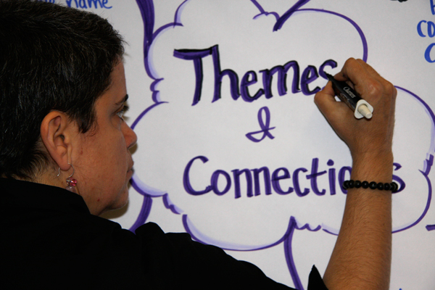
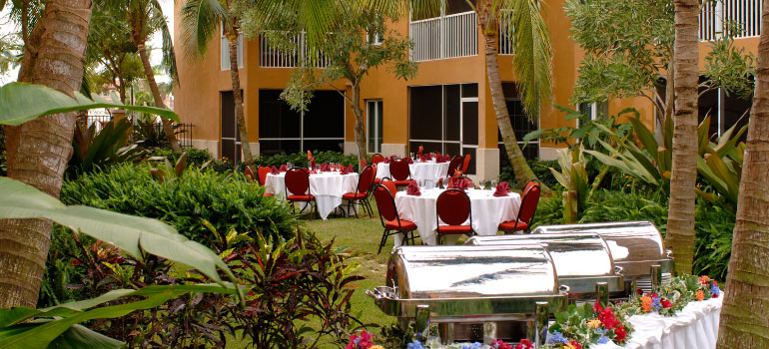
Programs and Meetings
Planning
Choose Theme, Objective…or Learning Outcomes
Notes:
READ - Many chapters have found it helpful to have meetings centered around a general theme; some examples of meeting themes include:
Sports, Barbecues, Leadership, Motivation
NOTE: if teaching training live, you could ask the group to list some additional themes that could be used.

Slide 13

Programs and Meetings
Planning
Advance Planning
How far out do you plan?
Do you link programs to community or company objectives, directions, products, etc?
Notes:
1) READ - Advance program planning is critical to success. One must allow enough time to organize and secure facilities, speakers, etc.
2) READ the slide
3) READ - To pull off good programs you have to be strategic and be thinking ahead all the time.
4) READ - At our chapter the Board meets in early January each year to map out the plan for the year. As the year matured our planning followed. Regular meetings of the Chapter officers and Board is essential to planning and preparing for monthly meetings and special events. This time also serves as a check point for marketing prior to the event and confirming the plan is on schedule and allows people to ask for help. Other chapters meet with company site lead to brainstorm activities that promote the companies objectives as well as the interest of our members.

Slide 14

Programs and Meetings
Planning
Determine Budget
What are some suggestions for cost savings?
Notes:
1) READ - As we said before, advance program planning is critical to success; knowing your Chapter budget is critical to the planning.
How can you project what kind of budget you should have for your programs? How have you learned to do more with less. “

Slide 15
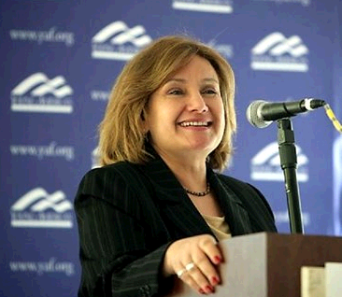
Programs and Meetings
Meeting Content
Opening Ceremonies
Spotlight Feature
Main Feature
Possible Food Event
Closing
Notes:
READ - These five bullets will be expanded upon in the following slides.
The opening ceremonies help to set the tone for your meeting.
In addition, the spotlight and main features will be the heart of your meeting, and should, therefore, receive utmost attention to detail.
Any other additional activities during or after your meeting can prove to be a beneficial way to get people to network, unwind, and end the meeting event on a positive note.
And, it’s important to close well. Now let’s look at these individually.

Slide 16
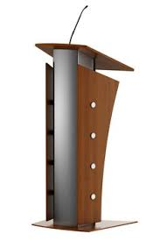
Programs and Meetings
Meeting Content
What type of meeting is it?
    Call to Order
    Invocation… yes or no?
    Singer
    Flag Salute
    Military Color Guard
    Chorus
    Table Games
    Mixer
    Secret Greeters
Notes:
READ - These are examples of the various items that may be included in the opening ceremonies.
Who will give the call to order? The invocation? The pledge? Introduce the guests? Etc .
Note; If teaching training live you may, encourage the group to list some additional items that may be part of the opening ceremonies.
In addition, discuss some questions that are often overlooked in opening ceremonies - such as those relating to WHO . . .

Slide 17

Programs and Meetings
Meeting Content
Spotlight Speaker:
Highlight parent organization
    New employee program
    Planned construction
    New products
Ask a customer or vendor to speak
Bring in someone from the community
--ALWAYS PROVIDE A TIME LIMIT--
Notes:
READ - Spotlight features should be short and not particularly related to the Main Feature. We have listed a few suggestions for a Spotlight Feature.
One important note. Spotlight speakers should ALWAYS be given a time limit. Far too many times a spotlight speaker will go on TOO long and take over your program. Ten minutes is usually enough time…especially if it’s before a meal!
Note; If teaching training live, you may ask “Who do the chapters in your group tend to use? Success stories?”

Slide 18
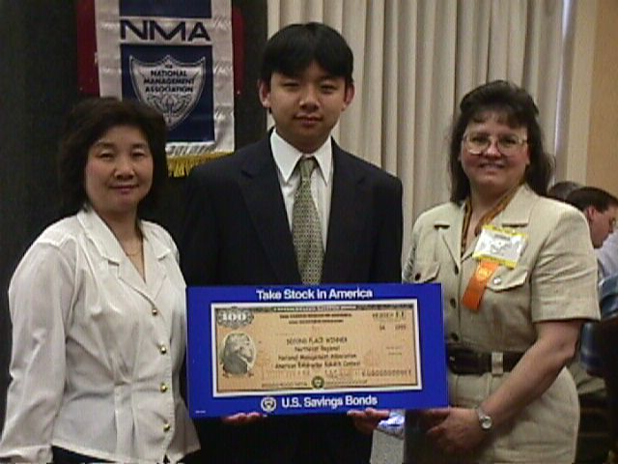
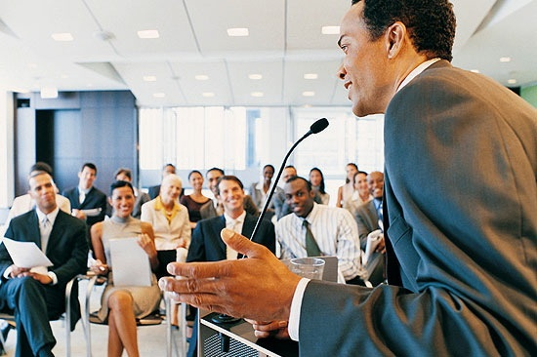
Programs and Meetings
Meeting Content
Main Feature
    Speaker
    Panel Discussions
    NMA Leadership Speech Contest
    Social Event
Notes:
1) READ the Slide
2) READ - At our chapter we have a secret hand shaker to increase networking. Ex; the 10th person that shakes the hand of the secret hand shaker will win tickets to our next LMLA event.
3) READ - We also have table sponsors at our dinner meetings; we assign a leader to each table, this allows members to sit at their table and interact with the company leader or executive. We are so compartmentalized that most employees do not get this type of opportunity during their normal work day.

Slide 19

Programs and Meetings
How and where do you find Speakers?
Notes:
READ - Getting the right speaker for your meeting can be quite a challenge. Many different items must be considered, such as:
Does the meeting have a theme?
Have the meetings had too many “serious” speakers, and is it time for something on the lighter side?
Do we not need a “speaker”, but rather something different … like a panel, film, etc…?
How much money is in the budget for a speaker?
Great ideas can be found from networking at NMA Annual conferences
Note; If teaching the training live, ask “What else can the group think of?”

Slide 20
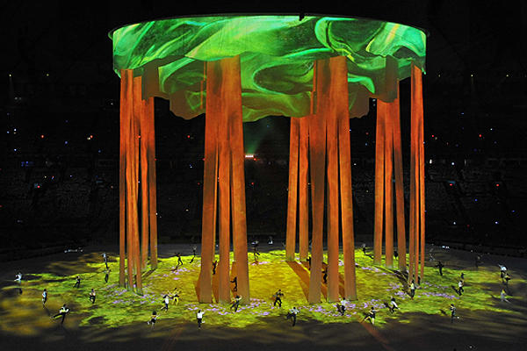
Programs and Meetings
Staging the Meeting
What is involved in “staging” a meeting?
Notes:
Read the Slide
Note; If teaching the training live; Display this slide before the group and allow them to provide answers and feedback before proceeding onto the next slide - which reveals the “official” answer to this question. Some participants will give answers that are found on the following slides, while others may offer new suggestions that are not listed. That’s okay, for there are many “correct” ways of doing things - the important thing is to have the foundation of the three fundamental steps.

Slide 21
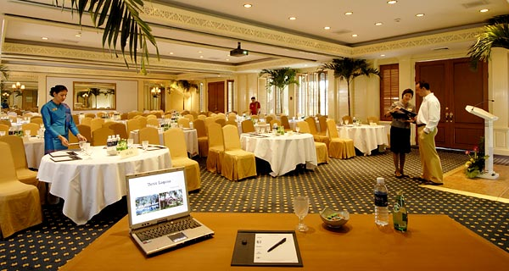
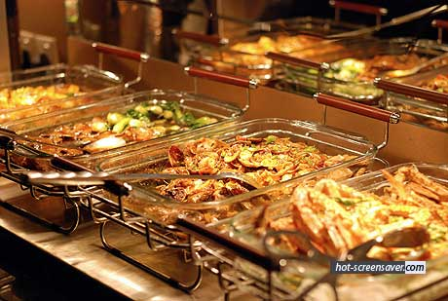
Programs and Meetings
Staging the Meeting
Location
    Permanent
    Varying
Food Service
    Type
    Menu
    Non-Dinner
Financial
  Arrangements
Physical Set-up
Audio-Visual
Notes:
1) Read - These are examples of the various details that are involved in “Staging” the meeting.
2) READ the slide
Note; If teaching the training live; You may choose to elaborate a little bit on each one, or just a few. This is a great place to solicit best practices and lessons learned.
Also, encourage the group to list some additional items that are involved in “staging” the meeting.

Slide 22
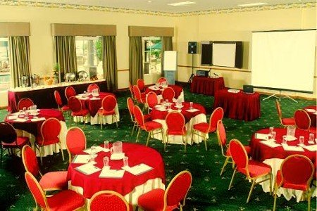
Programs and Meetings
Staging the Meeting
Meeting Hints:
Get there early and set up in time to greet
Check a/c, A/V, light controls, and be able to adjust background music easily
Arrange to have servers depart before your speaker begins
Notes:
READ the Slide
Note; If teaching the training live; Encourage the group to list some additional items that are involved in “staging” the meeting.

Slide 23
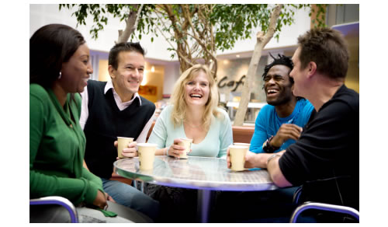
Programs and Meetings
Staging the Meeting
Foster the “sense of community” and make people feel good about themselves and one another.
People need to participate in your event, not just observe.
How do you foster that spirit?
Notes:
READ - For the most part, people CHOOSE to come to your event because they expect to have a nice time…and the definitions of that are all over the place. Yet the fact remains that most people want to FEEL good about having made the buying decision. You have to create that atmosphere of community.
Note; If teaching the training live; At your tables please discuss what keeps people from attending your meeting and what is the fix?

Slide 24



Programs and Meetings
Staging the Meeting
Notes:
READ - There’s an old saying about programs management: “Open and Close Strongly!”
Close your meetings professionally. Use the opportunity to highlight an upcoming event. Score points with the appropriate thank you’s.
At our chapter we give away door prizes at the end of the event and we do a 50/50 drawing and also raffle prizes along with a secret hand shaker award.
Note; If teaching the training live; ask “What are some good ways to end your event on a high note?”

Slide 25

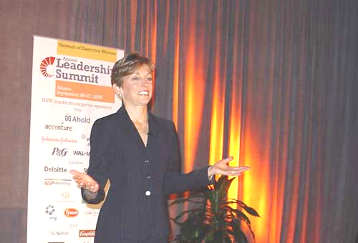
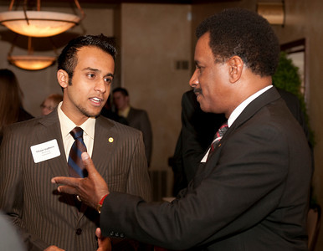
Programs and Meetings
Top Management Night
What are the Secrets of Success???
Notes:
READ: Top Management Night is a very well received meeting?
We actually hold Presidents Night at our chapter and we find that we have a higher attendance when an executive speaks.
This type of event also gives the employees an opportunity to network with executives.
Note; If teaching the training live; ask “How do you make the meeting spectacular? How do you make your chapter look value-added at top management night?”

Slide 26

Programs and Meetings
Be Strategic
What are strategies for getting senior management involved in your events during the rest of the year?
Notes:
1) READ the slide
2) Read – At our chapter we meet periodically with our chapter advisors and Champion, a company executive, to see what we can take off their plate. We are the conduit for communication between the company and the employee. Be sure to make your chapter value added for the company.
3) Invite them! Do all of your location executives KNOW about your Chapter? When is the last time you actually invited them to participate in a meeting? Or asked your Champion to get you as a Chapter leader invited to a sr. executive meeting?

Slide 27

Programs and Meetings
Green Meetings
Event planners increasingly asked to consider environmental impact:
  Waste management
  Resource and energy use
  Travel and transportation alternatives
  Facilities selection
  Site construction techniques
  Food provision and disposal
  Heating and air conditioning
Notes:
Read - Green conventions or green meetings are a huge international movement dedicated to protecting the environment by the use of wise choices during event planning, the event itself, and afterwards. Part of the sustainability movement.
Be prepared to deal with a company, individual, or group which asks you to document how “green” your function is!
There is lots of info available on line.
At our chapter we have often asked the event facility to box up the left overs and donate them to the local food shelter or homeless shelter.

Slide 28

Programs and Meetings
Chapter Programs Award
  Chapters recognized for excellence in monthly membership programs
  Within reach of ALL chapters
  Points tracked on CAR1
  “Chapter Outstanding Program Award” – goes to one chapter
Entry Form due at NMA June 1
https://nma1.org to download form
Notes:
A Chapter can receive this award by conducting monthly programs that enhance the members’ professional and/or personal growth when they attend the chapter’s membership meetings. It is within the reach of all chapters…in addition, we will present ONE CHAPTER OUTSTANDING PROGRAM AWARD to the chapter with the most accumulated points in this area. There’s a full “Programs Award” criteria explanation in the Recognition and Awards Guide that can be downloaded from NMA’s website.

Slide 29

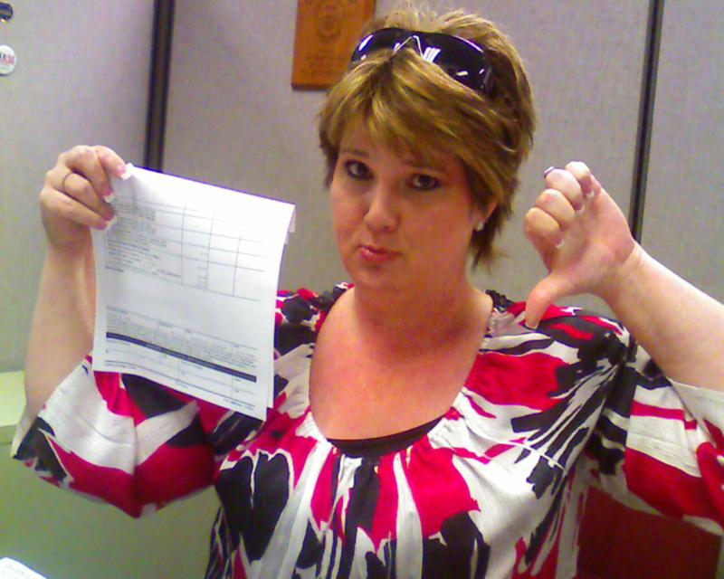
Programs and Meetings
Oops!!
When things go badly…and they will.
Notes:
READ the Slide
2) Read - At one Chapter….they had a facility that ran out of food. I had to quietly select 10 friends and board members to go to the restaurant next door to eat and then we sneeked back into our seats before the meeting began. No one was the wiser.
Note; If teaching the training live, ask the following; At your table please take a few minutes to discuss a program that bombed, how did you over come the situation?

Slide 30
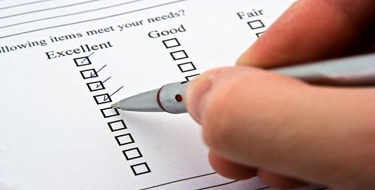
Programs and Meetings
Evaluation
How can you measure the effectiveness or success of your meetings?
Notes:
Read the Slide
Note; IF teaching the training live; Display this slide before the group and allow them to provide answers and feedback before proceeding onto the next slide - which reveals the “official” answer to this question. Some participants will give answers that are found on the proceeding slides, while others may offer new suggestions that are not listed. That’s okay, for there are many “correct” ways of doing things - the important thing is to have the foundation of the three fundamental steps.

Slide 31
Programs and Meetings
Evaluation – How did you do??
Program Evaluation
    Questionnaires
    Interviews
    Other
Solicit Suggestions for future meetings
Your Best Barometer:
  ATTENDANCE and Smiles!
Notes:
READ - These are examples of the various ways to evaluate the success of meetings.
There are some sample evaluation forms used by some of our chapters for their monthly programs in the guidebook. You may want to revise one of them for their use.
These are examples of the various ways to evaluate the success of meetings.
Note; If teaching the training live; encourage the group to list some additional items that are involved in meeting evaluation.

Slide 32
Programs and Meetings
Thank you for joining us!
Download guidebooks at:
https://nma1.org
Notes:
READ - Remember, if you wish additional copies of the guidebooks, they may be downloaded at:
https://nma1.org

