Slide 1

Deborah Davis-Leicht/Facilitator

Slide 2
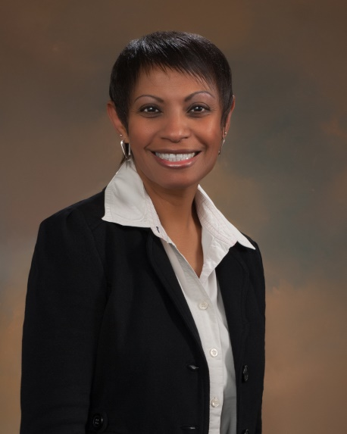
Professional Development
Today’s CLT Facilitator:
Deborah Davis-Leicht
Professional Development Committee Co-Chair
NMA Board of Directors
Fort Worth,TX

Slide 3

Leveraging NMA’s PD Resources
Professional Development at the Chapter Level
Now, more than ever, your NMA Chapter should be planning ahead and be ready to bring multiple opportunities for personal and professional development to your members. Everyone wins when that’s the goal …
Notes:
Once everyone is back to work after COVID-19, you need to be ready … be innovative and creative.

Slide 4

Leveraging NMA’s PD Resources
What’s in it for the … ?
Participants:
Gain new skills
Invest in their own careers
Build new relationships
Organization:
Support for a continuous learning environment
Cost-effective leadership training
Engagement of employees in their own development

Slide 5

Leveraging NMA’s PD Resources
Key Stakeholders
Senior Leadership – they can literally “see” value from the chapter they support
Human Resources and Training – the chapter is viewed as a “business partner” in achieving their people development goals
Members – view the chapter PD program as more personal and tuned to their needs, versus compliance training or mandated courses and workshops

Slide 6

First Things First!
Engage Human Resources
You are NOT a threat
You want to support ongoing training & development
You are there to help
Ask for someone from HR to advise the chapter; get HR/training ON the team!
Ask “What can we take off your plate?”
Provide feedback on needs to NMA

Slide 7
Leveraging NMA’s PD Resources
PD Committee: Who will be responsible for what?
Choosing the right mix of “classes,” programs, & events
Setting up meeting rooms
Handling publicity, registration, ordering materials
Getting CEU approval and submitting forms
Budgeting – what do things cost? How will courses/ programs be covered (chapter, individual, partnering with company?)
Finding facilitators/course leaders
Recognizing achievements

Slide 8
Leveraging NMA’s PD Resources
Let’s look at some NMA PD Products
Foundations of Management
Building Virtual Teams
NMA LeaderLabs (9 courses)
Live OnLine monthly webinar
FaciliSkills – under revision
New self-study library coming soon
Remember: Complete course details, pricing, and ordering details are all on the NMA website!
Notes:
Summary slide

Slide 9
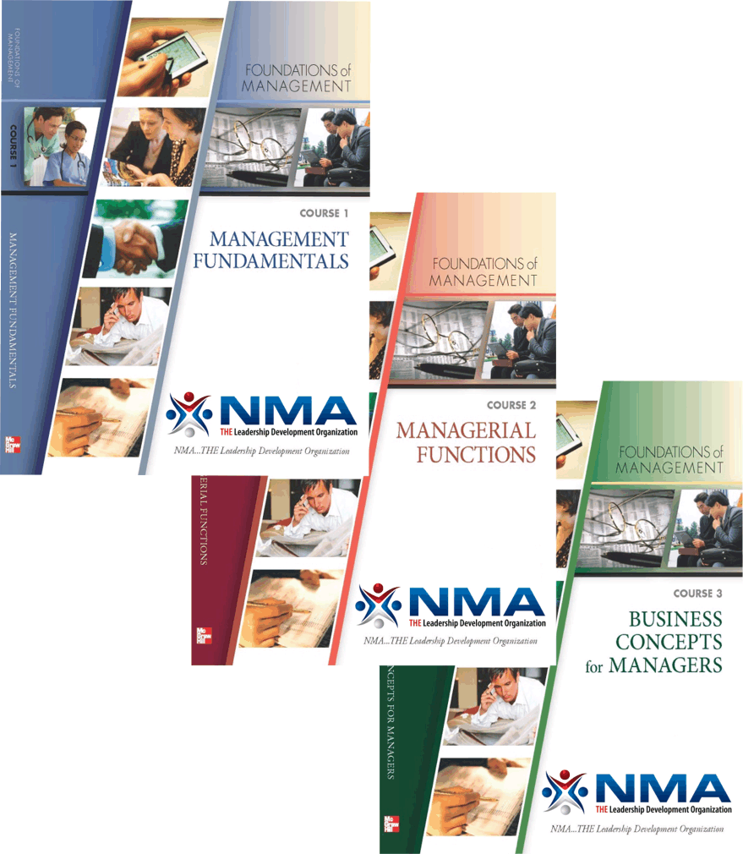
Leveraging NMA’s PD Resources
Foundations of Management
  Course 1: Management Fundamentals
  Course 2: Managerial Functions
  Course 3: Business Concepts for Managers
Details at nma1.org!
Notes:
Background Info for you; not suggesting that you read it1
Foundations of Management
3 courses; 14 chapters in all;
The program consists of three power-packed courses providing essential knowledge and tools for managers, supervisors, and leaders at all levels of experience. Its purpose is to establish a strong foundation from which to achieve organizational results. Each course includes a custom‑published text book available in print or eBook format. The text books include pre‑ and post‑tests, key concepts to remember, reading comprehension questions, and self‑assessments.
Course 1: Management Fundamentals
This first course covers the manager’s role in the workplace, discovering the leader within you, developing effective communication skills, solving problems and making ethical decisions, and delivering first rate customer service.
Course 2: Managerial Functions
The second course covers planning for goal achievement; organizing work, relationships and teams; staffing, training and appraising; leading and motivating people; and controlling to improve results.
Course 3: Business Concepts for Managers
The third course covers the business environment, the role of economics in business, basic concepts of information technology, and managing accounting and financial information.

Slide 10

Leveraging NMA’s PD Resources
Building Virtual Teams
Five chapters, all dedicated to understanding the characteristics, challenges, and opportunities that come with working on virtual teams … ANY team, to be honest!
Analyze Virtual Workplace Realities
Overcome Distance and Cultural Factors
Feel the Impact of Accountability and Shared Vision
Learn How to Mitigate Conflict
Identify Outstanding Best Virtual Practices
Details at nma1.org!
Notes:
Building Virtual Teams
Five chapters all dedicated to understanding the characteristics, challenges, and opportunities that come with working on virtual teams. Designed for facilitated group discussion.
Participant manual - $50; $25 with Chapter Rewards discount
Leader Guide - 499

Slide 11

Leveraging NMA’s PD Resources
Engage Your Members
Monthly Live OnLine Webinars
Third Thursday of the Month – 12:00 noon and 3:00 pm EST
Details at nma1.org!
Coming May 21: “The Art of War … From the Broadsword to the Boardroom”
All are archived on our website
for viewing 24/7!

Slide 12
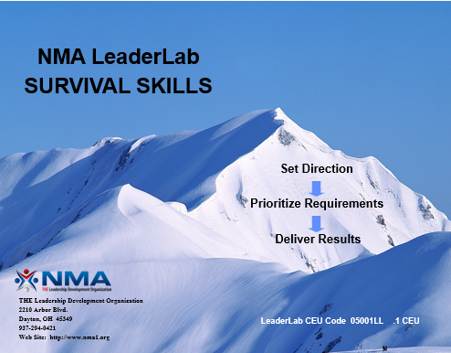

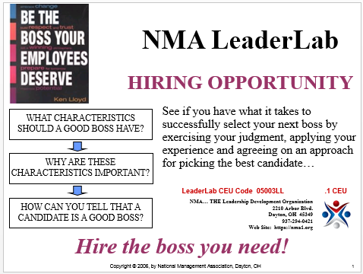
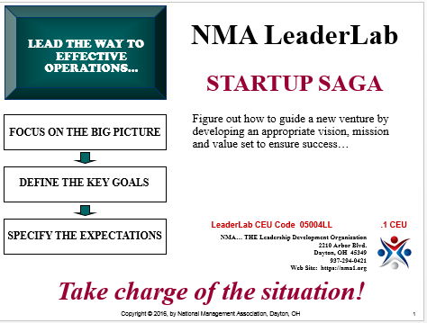
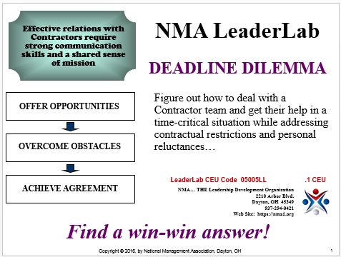
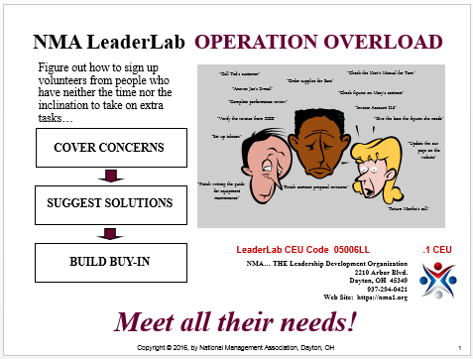
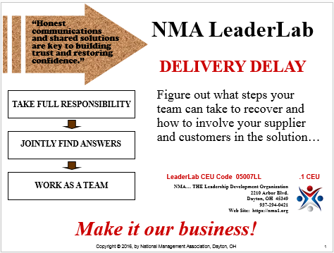
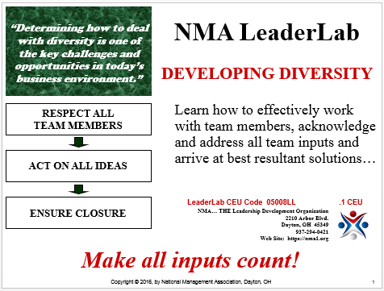
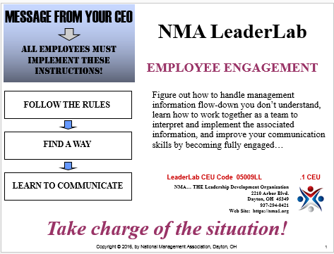
Leveraging NMA’s PD Resources
NMA LeaderLabs
Interactive scenario-based learning sessions
Survival Skills – Priorities under pressure
Apprentice Auction – Selling with substance
Hiring Opportunity – Cover your criteria
Startup Saga – Minding the mission
Deadline Dilemma – Give and take
Operation Overload – Find a fix
Delivery Delay – Satisfy your customer
Developing Diversity – Invite all ideas
Employee Engagement – Walk the talk
Details at nma1.org!
Notes:
NMA LeaderLabs
Live, interactive scenario-based learning sessions to immerse participants in critical thinking and teambuilding exercises.
The LeaderLabs are exciting, fast-paced scenario-based learning. In one hour, you and your team will be presented with a leadership challenge that begs for innovative solutions.
In order to run a LeaderLab you need to have at least 2 teams of 5-8 people… the more teams the better. You also need about one hour to conduct the lab. You can offer prizes to make it more interesting. Click on the URL address for the handouts and more detailed instructions.
These are free to all chapters; simply download from NMA website.
9 courses
Survival Skills – Priorities under pressure
Apprentice Auction – Selling with substance
Hiring Opportunity – Cover your criteria
Startup Saga – Minding the mission
Deadline Dilemma – Give and take
Operation Overload – Find a fix
Delivery Delay – Satisfy your customer
Developing Diversity – Invite all ideas
Employee Engagement – Walk the talk

Slide 13
Leveraging NMA’s PD Resources
New for 2019-2020
NMA On Line Library:
  Leadership & Influence
  Change Management
  Emotional Intelligence
  Goal Setting & Getting Things Done
  Assertiveness & Self Confidence
  Generation Gaps
Six self-paced, 1 hour courses; only $39!
Details at nma1.org!
Available for BOTH Group Discussion/Study or Self-Study Online Programming!

Slide 14

Leveraging NMA’s PD Resources
Now Available:
FaciliSkills™
Leader Guide for each course: $59
Participant Manual for each course: $59
20% off with Chapter Rewards Dollars
How to run effective meetings, any time, anywhere
How to facilitate trust and open communication
How to engage others in discussion
How to use the best tools for handling conflict, “reading the room”, and creating group synergy
Details at nma1.org!
Newly redesigned:
  Three courses
  Facilitator and Student Guides
  PPT based

Slide 15
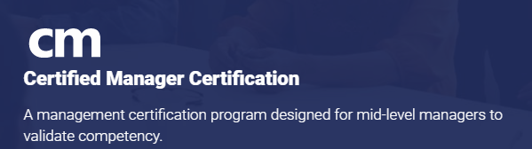
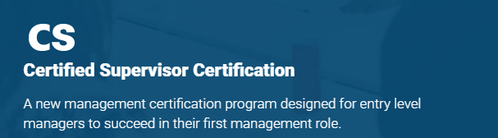

Leveraging NMA’s PD Resources
Certified Manager & Certified Supervisor Programs
NEW!
Verify your ability to manage and lead
Meet Eligibility Requirements; need not have a “management title”
Pass 3 CM assessment exams
Begin your management career with affordable, independent learning
Are you currently supervising others or aspiring to be a supervisor? If so, the CS is designed for you.
The real-world knowledge and skills you will learn through the CS can be used immediately to help you become a more efficient, effective supervisor.
icpm.biz
Details at nma1.org!
Notes:
Study Books and E-Learning Center Access
Each module of the Certified Manager Program consists of a printed study book, access to ICPM's e-Learning Center, and a CM certification exam. ICPM's e-Learning Center contains multimedia learning resources such as PowerPoints, quizzes, notes and outlines to reinforce learning and to test your knowledge.
The CM certification, inclusive of learning materials, can be purchased by the bundle--one payment of $850 + shipping for international purchases (free shipping in the US)--or by the module--three payments of $305 + shipping for international purchases (free shipping in the US).
Applicants that do not desire to purchase ICPM's learning materials can purchase the CM application and three exams for $555 US dollars.

Slide 16
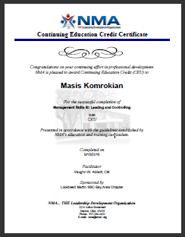
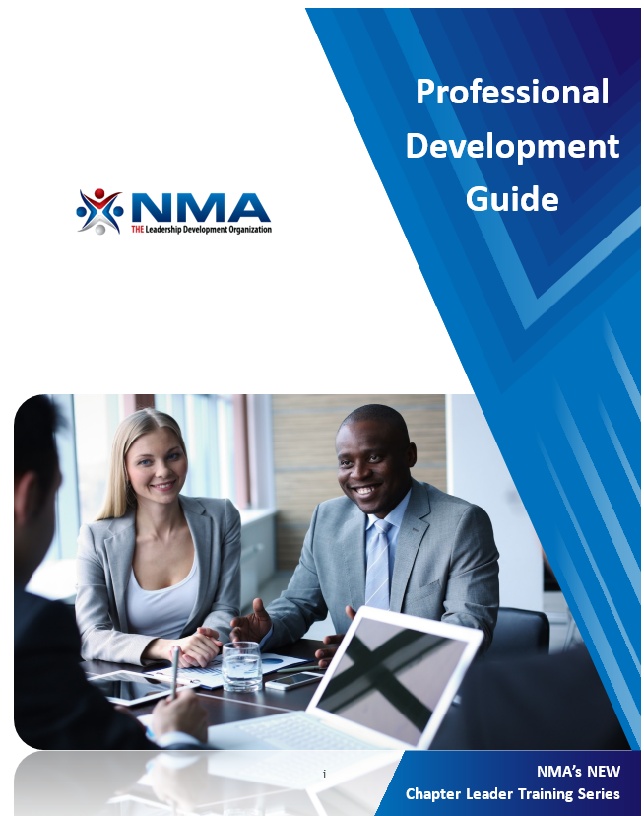
Leveraging NMA’s PD Resources
Additional PD Resources
Professional Development Guidebook
  Developing a PD plan
  Description of processes
    Forms (B3, B4, B5, etc.)
  All about CEU
  Developing Facilitators
  Ordering courses
  Requesting certificates
Download at nma1.org!

Slide 17

Leveraging NMA’s PD Resources
Chapter Rewards Program
REMEMBER! You have a $2/member dues rebate that can be used toward the purchase of NMA awards, conference registrations, and educational materials. Contact NMA for your current Chapter Rewards “balance”.
Notes:
Foundations of Management – 20% off
FaciliSkills™ ‐ 20% off
Building Virtual Teams – 50% off
Live Online Group Login – 100% off
Awards and merchandise – 10% off the purchase price of all awards and merchandise
LDC Registrations (in addition to the Early Bird Discount!) – 10% off
Annual Conference Registrations (in addition to the Early Bird Discount) – 10%off
President and Past Presidents Pins – 20% off

Slide 18
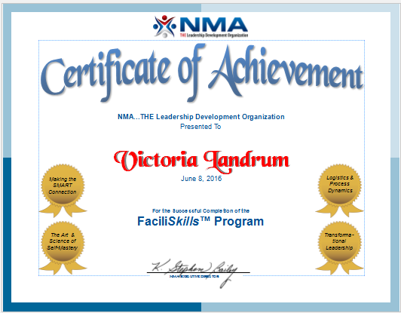
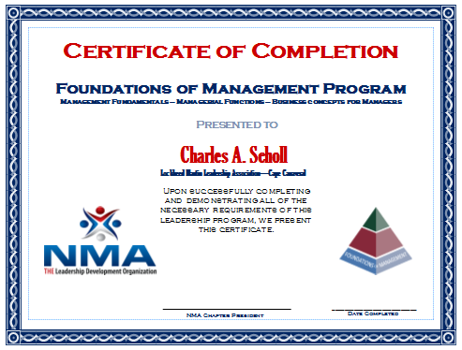
Recognition
Recognize People’s Achievements!
Chapter Meetings
Executive Staff Meetings
Chapter Newsletters
E-blasts, website posts
Notes to Supervisors
Bulletin Boards
Ask execs to personally hand out achievement certificates!
Notes:
People like to be recognized for their professional achievements. One way to do this is to present (at a chapter event) certificates for those members who have completed a course of study.
Your newsletter can do more than inform. Make sure when people do finish classes, it gets noted in the newsletter with their department name (or company name for community chapters). You might include their pictures, also. Get a little competition going between groups. Make sure to call attention to the fact that a whole department or company participated.
It gives you another vehicle to showcase your people.

Slide 19
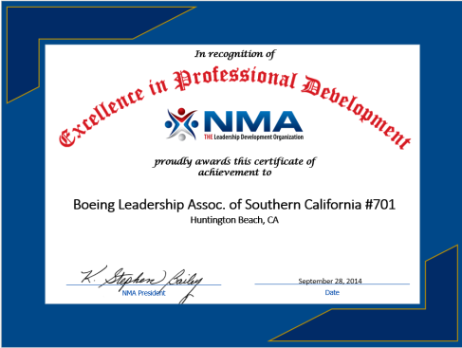
Professional Development Award
Celebrate Your Successes
Presented to any Chapter that has an outstanding PD and CM Program through conducting both NMA and non-NMA courses, and involving executive managers in their Professional Development program. Be recognized at NMA’s Annual Conference.
Details at nma1.org!
Notes:
Chapters that participate in the NMA’s Awards Program by submitting a monthly CAR1 (Chapter Achievement Reporting Form) are automatically entered to earn this award. The Minimum points are a level that can be exceeded. Chapters shouldn’t stop their Professional Development activities once the minimum level is reached.
The CAR1 has a tab that provides a description of the requirements for the PD Award. It can also be found in the PPM which is on NMA’s website.

Slide 20

Q & A and Best Practices
  What really works and draws people to your learning activities?
  How do you pay for PD programs?
  Please share the kinds of “other” PD programs that seem to work for your chapter?
  Can you recall any unforeseen successes and/or “epic failures”?
  What would you like to learn from others who are logged on?

Slide 21
Leveraging NMA’s PD Resources
Thank you for attending!

